Slide 1

The Augmented Conversation
David A Smith
CTO Croquet Corporation
david@croquet.io

Slide 2
The Metaverse is A Communication Medium

Slide 3

Language is a virtual machine running on top of the hardware that makes up your brain.
It enables you to think and understand things that your primitive brain could never reach.
You think in terms of language. And not just speech.

Slide 4
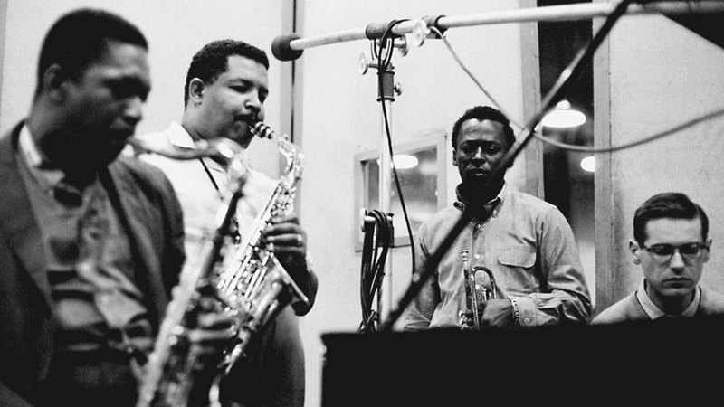
Any musician will tell you that music is a language – it enables you to share thoughts and feelings that aren’t possible otherwise.

Slide 5
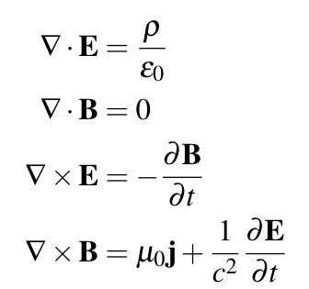
Mathematics is an incredibly powerful language that we use to understand and control the possibilities of the universe. It was essential for us to create the world we live in today. But again, it is a virtual machine running on our brains.

Slide 6
The metaverse is an incredibly powerful and rich language that enables an augmented conversation where the ideas we express are amplified and made real by the computer.

Slide 7
You are defined more than anything by how you communicate. The metaverse will redefine what we are and what it means to be human.

Slide 8
But how?

Slide 9
The Augmented Conversation
Allows us to jointly invent and explore new universes.

Slide 10
Features of the Augmented Conversation 1
A discussion within a group of users that is extraordinarily enhanced with the kinds of tools and capabilities that are only available with a computer.

Slide 11
Features of the Augmented Conversation 2
The computer AI is a full participant in this conversation. It allows us to jointly discuss and explore complex systems, data sets, and simulations as naturally as we talk about the weather.

Slide 12
Features of the Augmented Conversation 3
A guarantee of shared truth.
The simulation I see must be the exact same as what you see.
Anything I do to affect the shared simulation must also be accurately shared.
Otherwise, you can’t trust the communication channel.

Slide 13
Features of the Augmented Conversation 4
The shared system must enable bit identical modification and extensions of that system for all participants.
Thus, we can use the system itself to extend the system to improve it and add new capabilities.

Slide 14
Croquet Demo

Slide 15

Buckminster Fuller
“You never change things by fighting the existing reality. To change something, build a new model that makes the existing model obsolete.”

Slide 16
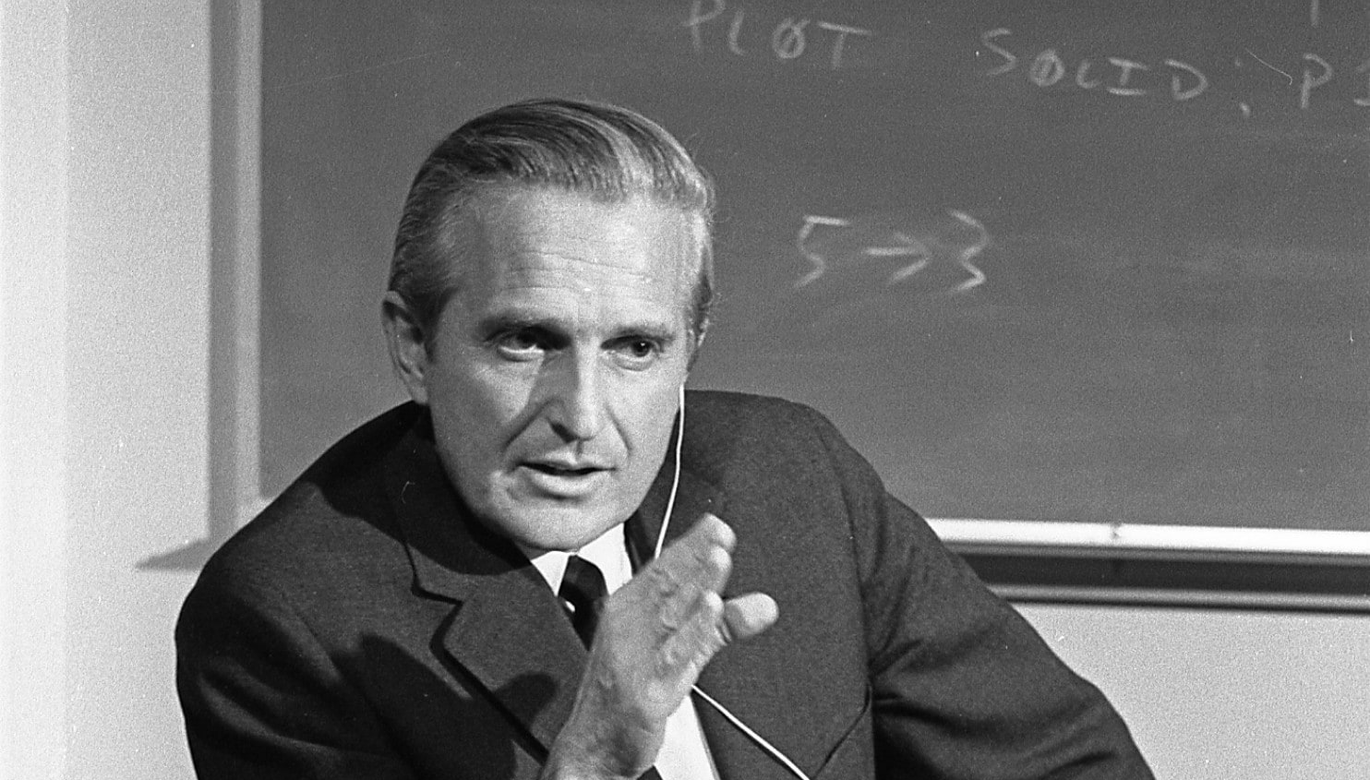
“The key thing about all the world's big problems is that they have to be dealt with collectively. If we don't get collectively smarter, we're doomed.”
Doug Engelbart

Slide 17
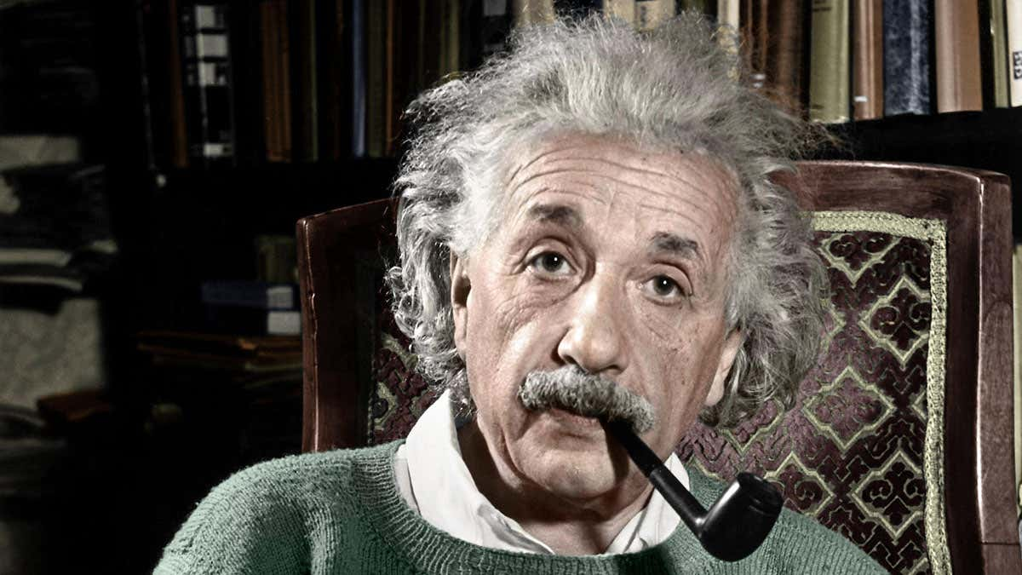
“We cannot solve our problems with the same thinking we used when we created them.”
Albert Einstein

